Slide 1



Artificial Neural Networks
INTRODUCTION TO MACHINE LEARNING
- Ashwina Rakish

Slide 2
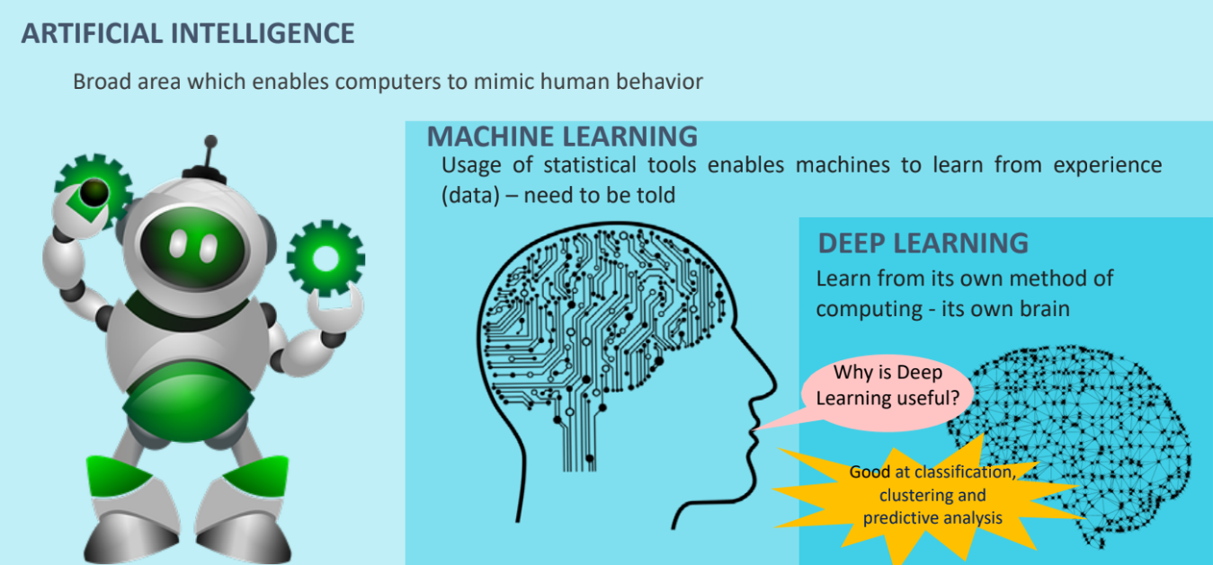
Deep Learning

Slide 3
Deep Learning
Deep learning is a branch of machine learning which is based on artificial neural networks.
It is capable of learning complex patterns and relationships within data and does not require us to explicitly program everything.
It has become increasingly popular in recent years due to the advances in processing power and the availability of large datasets.
Automatic Feature Extraction: Deep learning models, especially neural networks, automatically learn relevant features from raw input data during the training process.

Slide 4
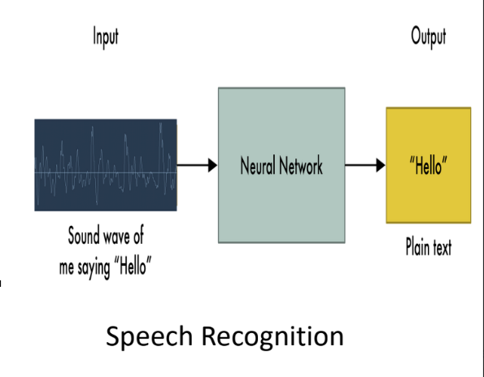
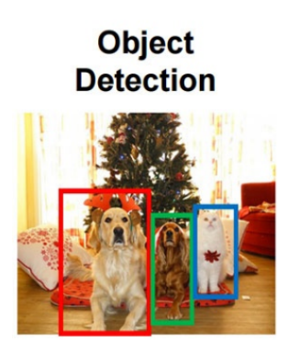
Deep Learning
It can be used for object detection, image segmentation, image classification, image generation, text generation, sentiment analysis, translation…

Slide 5
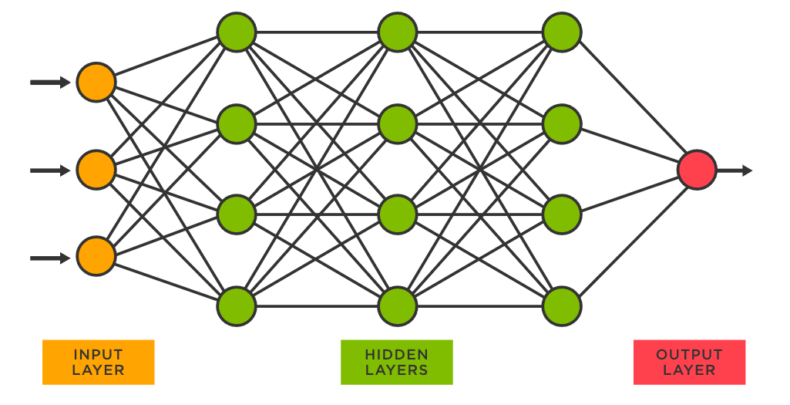
Artificial Neural Network (ANN)

Slide 6
ANN - Architecture
A basic neural network has interconnected artificial neurons in three layers:
Input Layer
Information from the outside world enters the artificial neural network from the input layer. Input nodes process the data, analyse or categorize it, and pass it on to the next layer.
Hidden Layer
Hidden layers take their input from the input layer or other hidden layers. Artificial neural networks can have a large number of hidden layers. Each hidden layer analyses the output from the previous layer, processes it further, and passes it on to the next layer.
Output Layer
The output layer gives the final result of all the data processing by the artificial neural network. It can have single or multiple nodes. For instance, if we have a binary (yes/no) classification problem, the output layer will have one output node, which will give the result as 1 or 0. However, if we have a multi-class classification problem, the output layer might consist of more than one output node.

Slide 7
How does it work?
It takes certain inputs and weights.
Applies dot product on respective inputs & weights and apply summation.
Apply some transformation using activation function on the above summation.

Slide 8
How does it work?

Slide 9
ANN - Architecture
1. During the training phase, the neural network is initialized with random weight values.
2. Training data is fed to the network and the network then calculates the output. This is known as a forward pass.
3. The calculated output is then compared with the actual output with the help of loss/cost function and the error is determined.
4. Now comes the backpropagation part where the network determines how to adjust all the weights in its network so that the loss can be minimized.

Slide 10
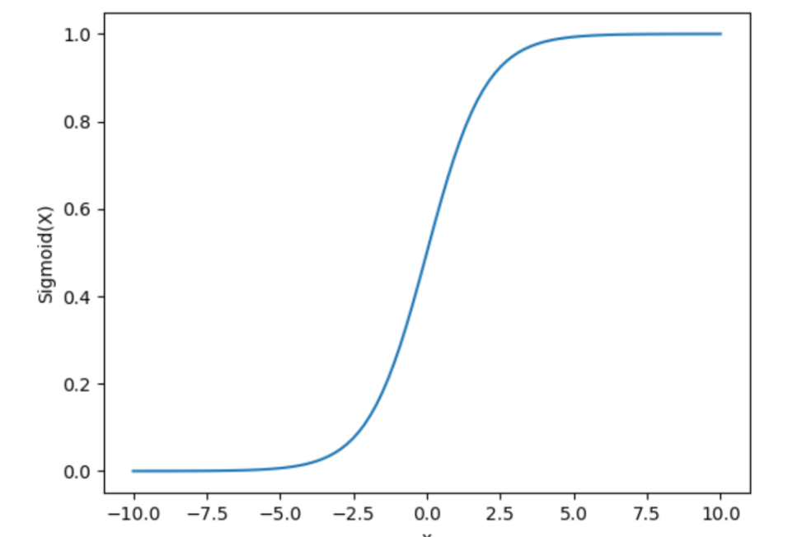
Activation Functions
An activation function brings nonlinearity to the network.
Sigmoid function:
Range: 0 to 1
Use: Used in binary classification.

Slide 11
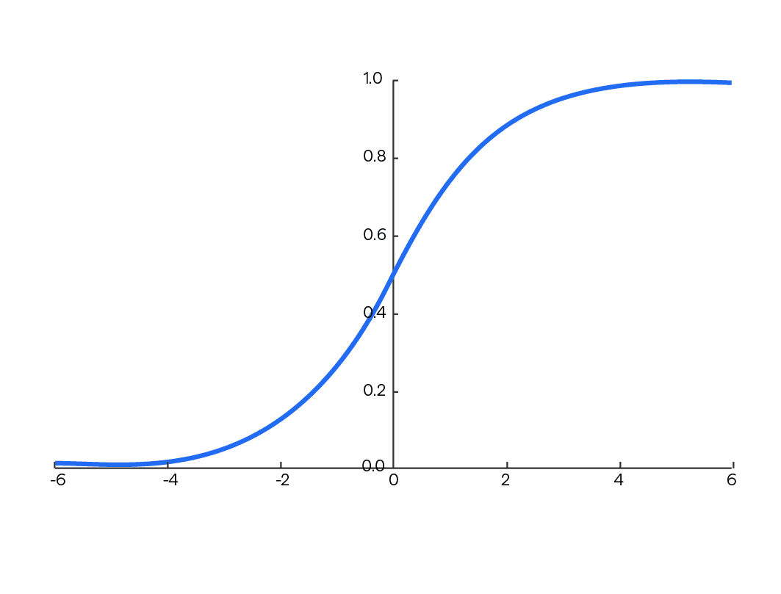
Activation Functions
SoftMax:
Range: 0 to 1 for each output and will sum upto one.
Use: Multiclass classification

Slide 12
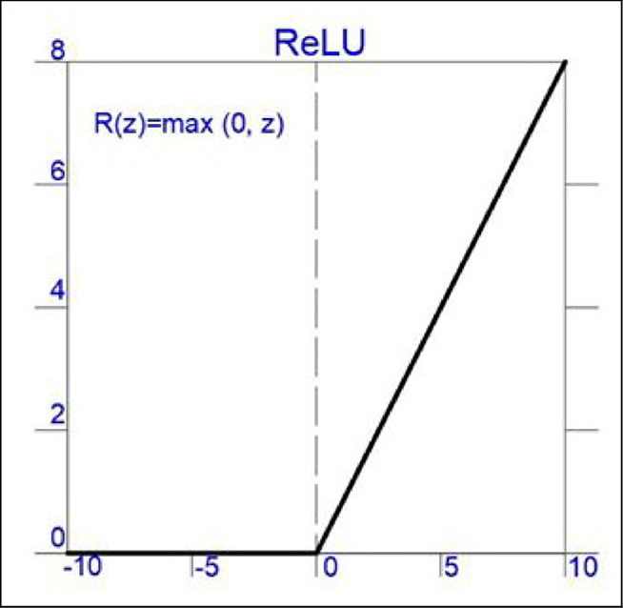
Activation Functions
ReLU: Rectified Linear Unit
Range: 0 to infinity
Use: Usually used in Hidden layers

Slide 13
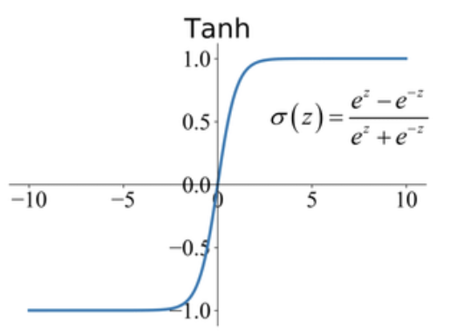
Activation Functions
tanh: Hyperbolic Tangent
Range: -1 to 1
Use: Usually used in Hidden layers

Slide 14
QUIZ

Slide 15
Question: What would happen if there is no activation function used?
Answer: It would act like a simple linear regression model.

Slide 16
Question: Do we have to perform feature selection for neural networks?
Answer: No

Slide 17
Question: Do we have to perform data preprocessing for neural networks?
Answer: Yes

Slide 18
Question: Which activation function can be used for binary classification?
Answer: Sigmoid

Slide 19
Question: In which activation function does all the values add up to one?
Answer: Softmax

Slide 20
Thank You!

